Slide 1


Advanced Methods in Data Science - DTSC104
Milestone 2
ANN Algorithms
Introduced by
Omnia Gad
Nardeen Shaheer
Nourhan Reda Abdelall

Slide 2
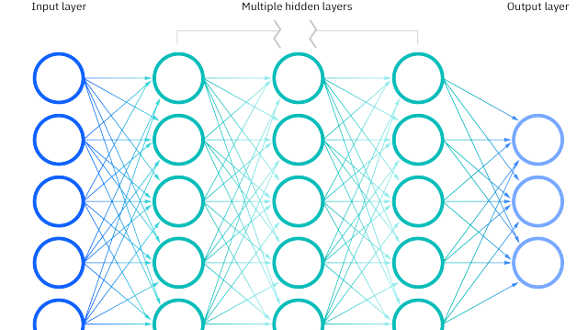
ANN algorithms :
The main purpose of a neural network is to try to find the relationship between features in a data set.
it consists of a set of algorithms that mimic the work of the human brain
Artificial neural networks (ANNs) are comprised of a node layers, A “neuron” in a neural network is a mathematical function that collects and classifies information according to a specific architecture.
ANN containing an input layer, one or more hidden layers, and an output layer.
Each node, or artificial neuron, connects to another and has an associated weight and threshold. If the output of any individual node is above the specified threshold value, that node is activated, sending data to the next layer of the network. Otherwise, no data is passed along to the next layer of the network.
Neural networks rely on training data to learn and improve their accuracy over time.
It classify and cluster data at a high velocity

Slide 3
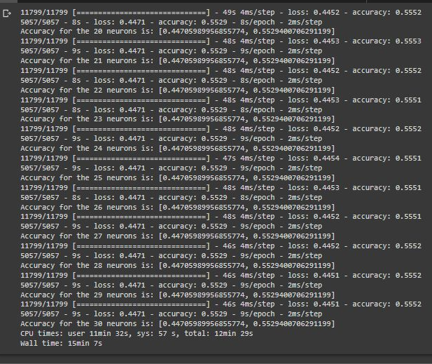
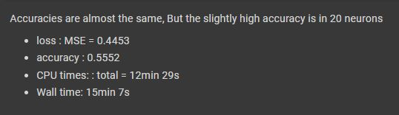
each individual node as its own linear regression model, composed of input data, weights, a bias (or threshold), and an output. The formula would look something like this:
∑wixi + bias = w1x1 + w2x2 + w3x3 + bias
output = f(x) = 1 if ∑w1x1 + b>= 0; 0 if ∑w1x1 + b < 0
the goal is to minimize our cost function to ensure correctness of fit for any given observation
Building ANN
The first thing we need to do before building a model is to create a model object itself
Adding the first fully connected layer
Hyperparameters:
number of neurons:
we vary from (20 to 30) neuron
The best # of neurons or cell is 20

Slide 4
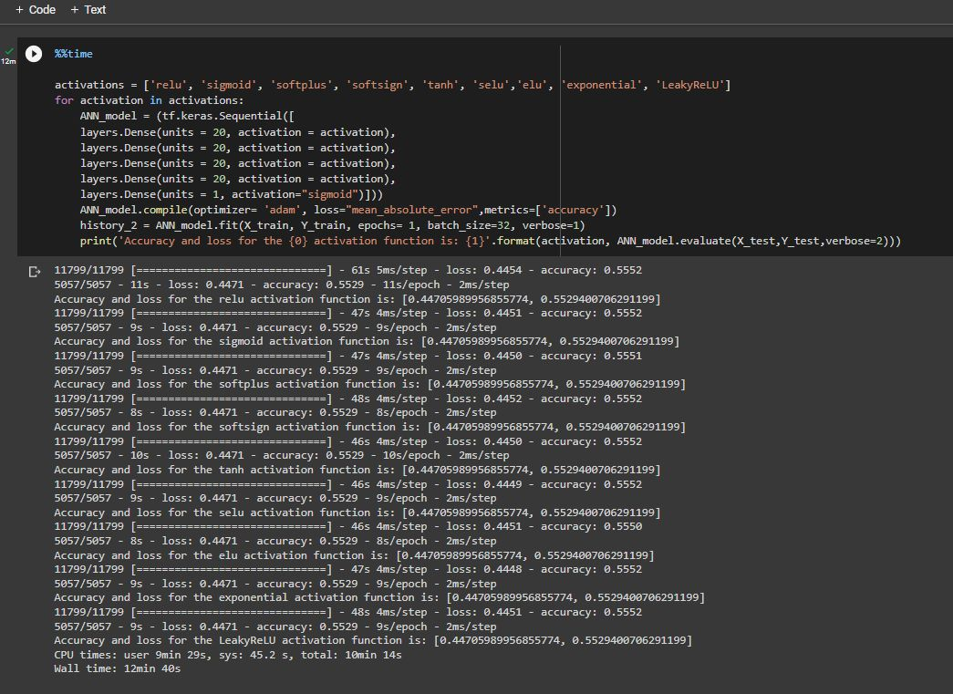
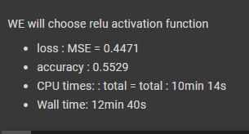
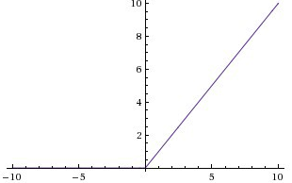
activation function:
The activation function decides whether a neuron should be activated or not by calculating the weighted sum and further adding bias to it. The purpose of the activation function is to introduce non-linearity into the output of a neuron.
Linear Function
Range : -inf to +inf
Sigmoid Function
Value Range : 0 to 1
RELU Function
Equation: f(x) = a =max(0,x)
Value Range :- [0, +∞]
Derivative: f’(x) = { 1 ; if z>0, 0; if z<0 and undefined if z=0 }
according to our case the best activation function is relu

Slide 5
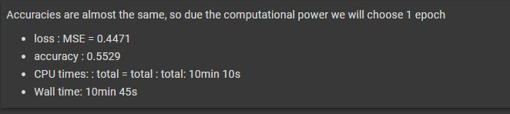
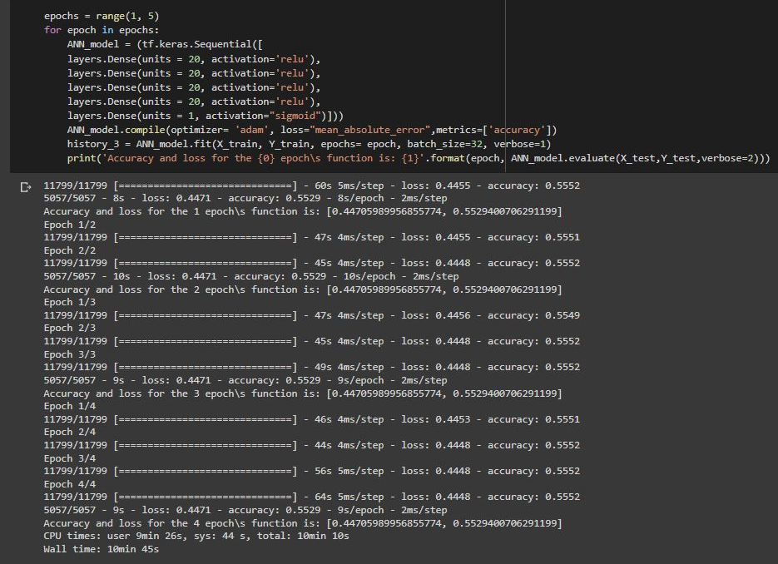
Hyperparameter number of epoch:
We use range number of epoch =(1-5)
According to our case there is no
change in MSE or accuracy
so we choose
Number of epoch =1
So we safe our computational
power.

Slide 6
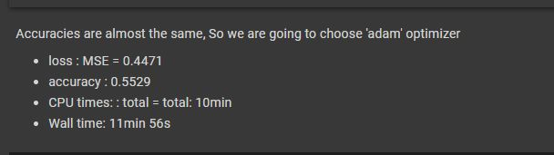
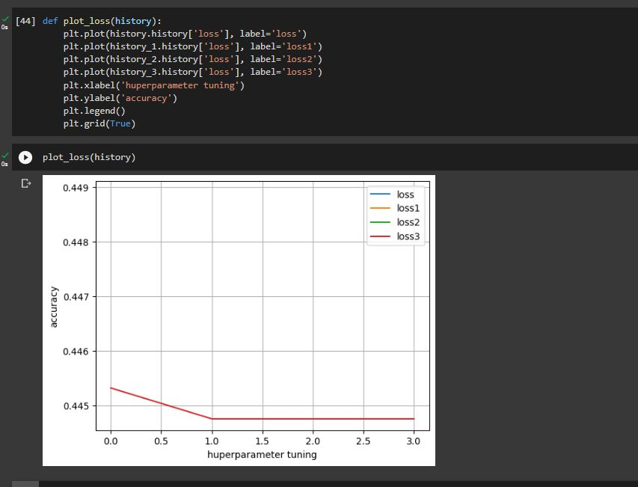
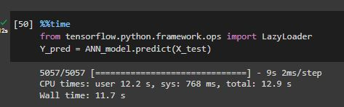
The final conclusion :
The best number of neurons or cell is 20
The activation function used is RELU Function
The number of epoch used is 1
The optimizer used is Adam as all optimizers are the same results ,and Adam is common
When used the hyper parameters all with each other it give us this visualization
They are 4 lines but overlap as they MSE and accuracy are the same.
The time taken in the prediction process is 11.7sec

